Slide 1
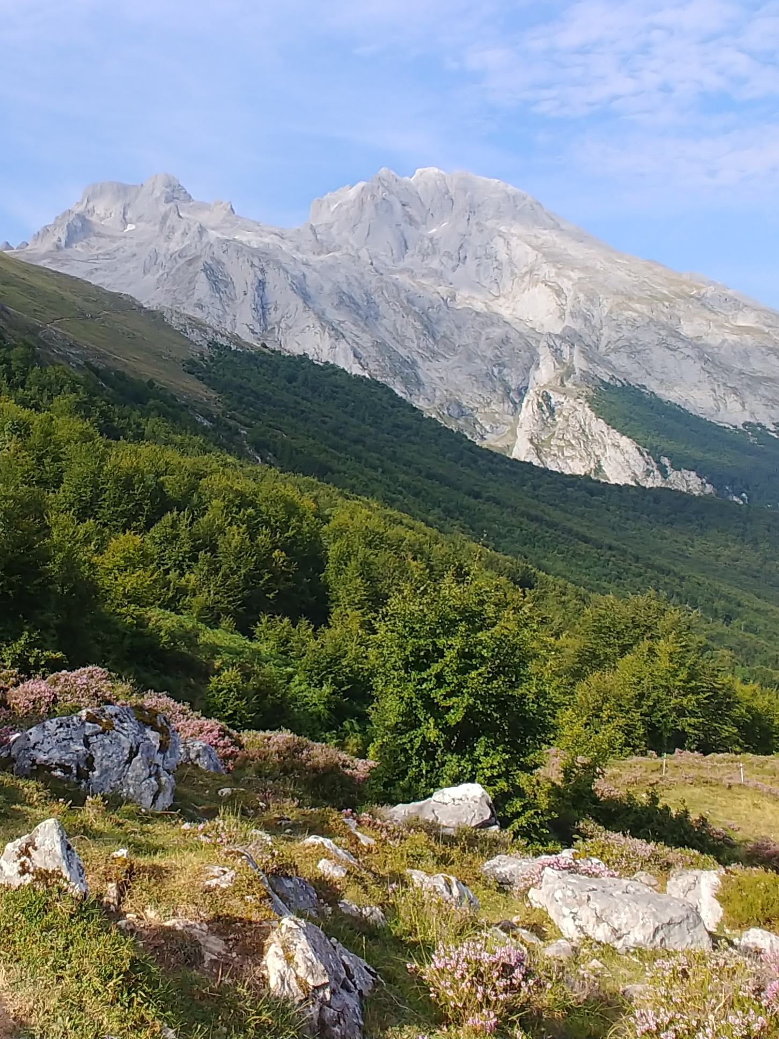
(a) Fatty acids biochemical properties
(b) Altitudinal expected gradient
 | Unsaturated Fatty Acids | Saturated Fatty Acids
Production cost | Higher | Lower
Energy stored | Lower | Higher
Melting point | Lower | Higher
Oxidative damage | Higher | Lower
Unpatability | Higher | Lower
Antifreezing | Higher | Lower
Stereochemistry
O
O
HO
HO
Oil content (%)
UFA/SFA ratio

